Slide 1
Deep Evolutional Instant Interest Network for CTR Prediction in Trigger-Induced Recommendation
2024 WSDM
Reported by liang li

Slide 2
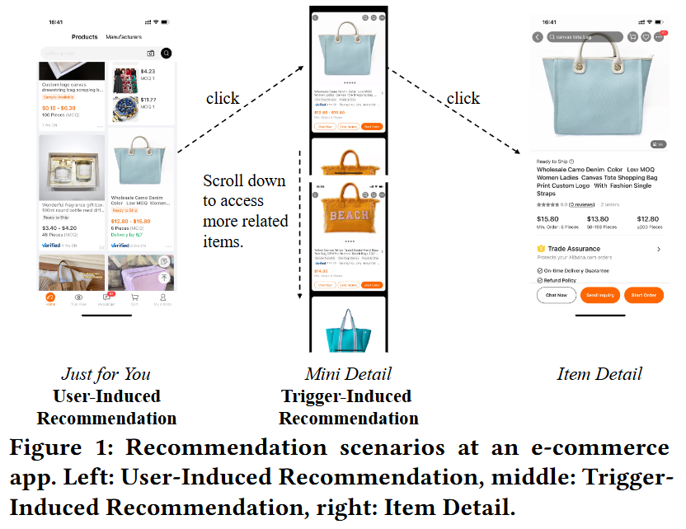
Motivation
Details：
Nevertheless, the temporal information of behaviors, the dynamic change of user instant interest when the user scrolls down and the interactions between the trigger and target items haven’t been considered.

Slide 3
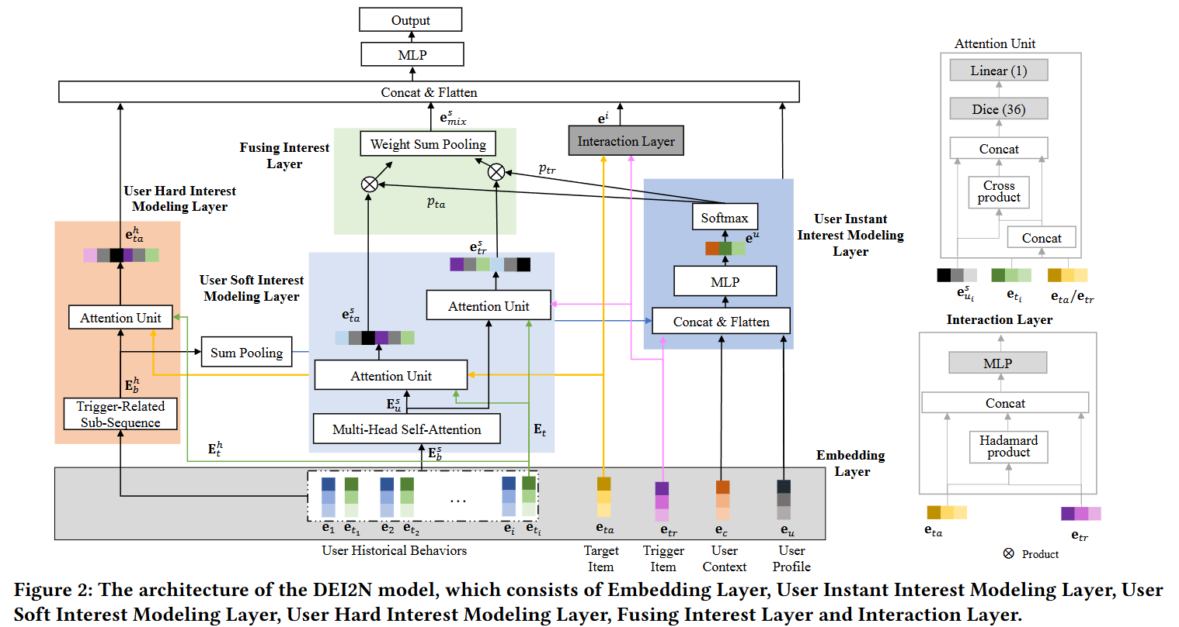
Problem Statement

Slide 4
Method

Slide 5
Experiments

Slide 6
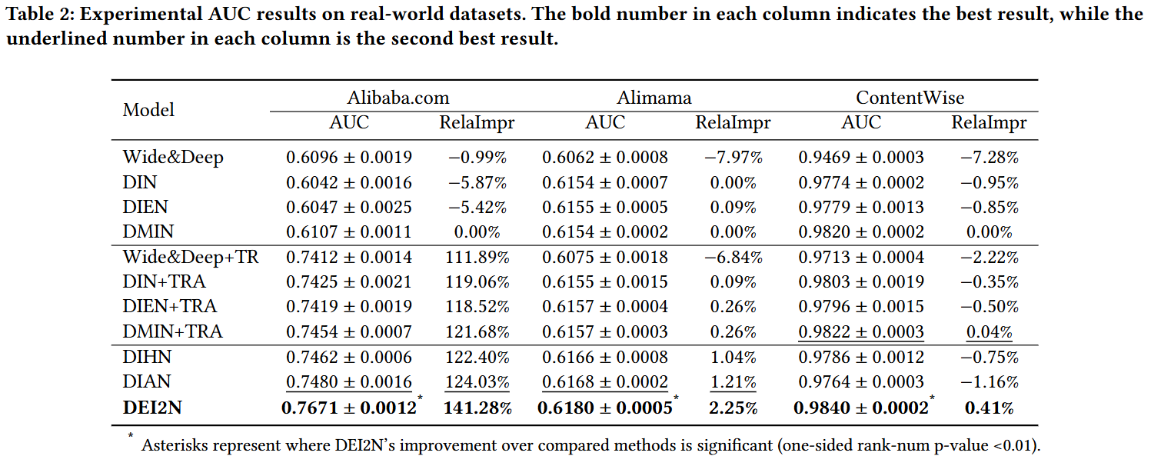
Experiments

Slide 7
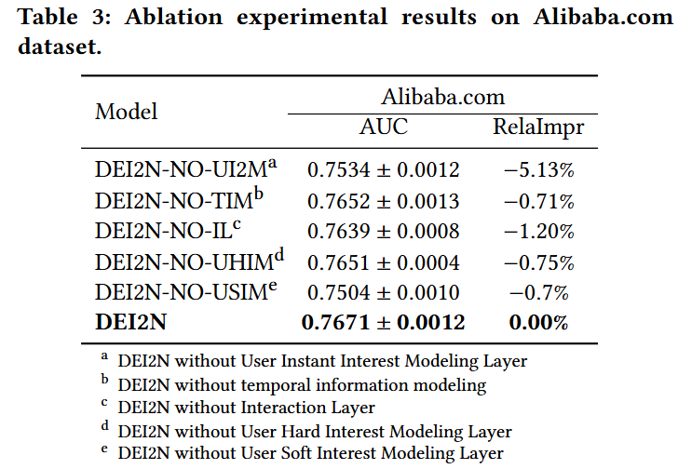
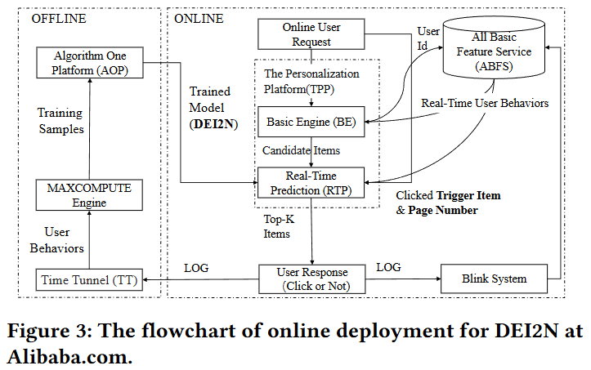
Experiments

Slide 8
Thanks

